Slide 1

AI-Driven Testing Revolution: First Steps Towards Building Autonomous Test Agents
AI Community Days Tunis
08/11/2025
Majdi ZLITNI

Slide 2
What if an AI agent can automate the testing for us?

Slide 3

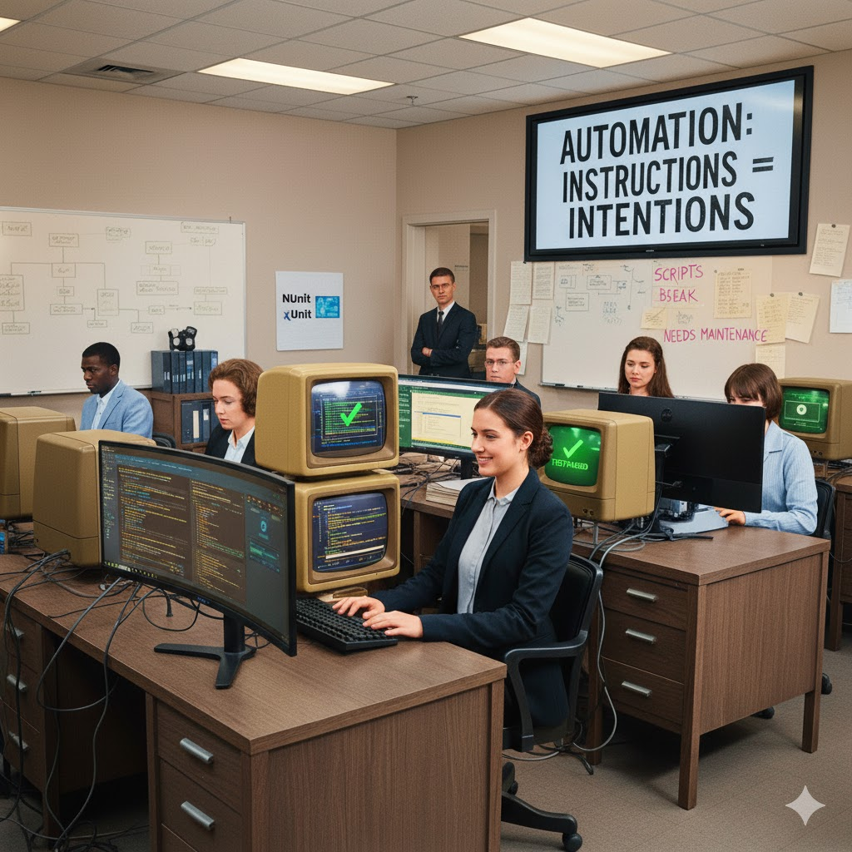
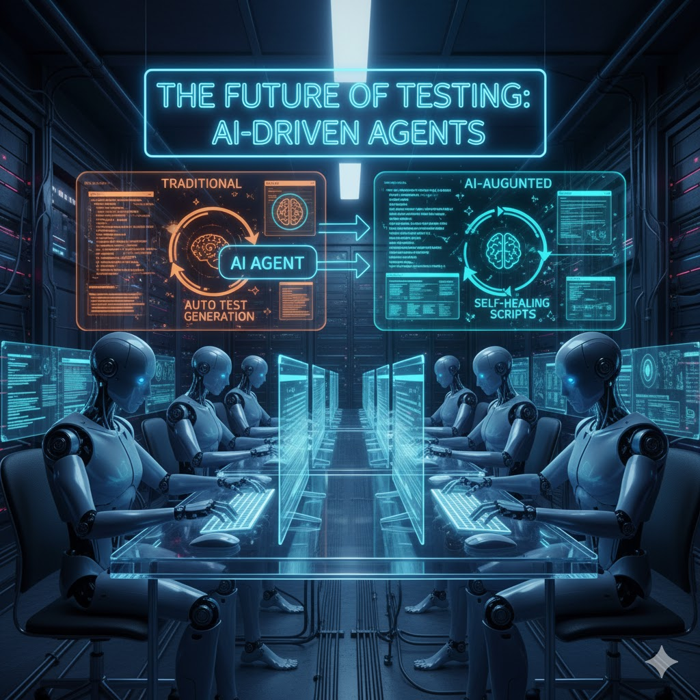
Manual testing
Automation testing
Agentic testing
The endless testing cycle
The Script Maintenance Trap
Toward Intelligent Testing Era

Slide 4





Majdi ZLITNI
Software Consultant
.NET & C# Specialist
majdi-zlitni
majdiz.tn
majdi-Zlitni

Slide 5
Table of contents
01
02
03
04
The Building Blocks of an AI Agent
AI Testing Agent a high-level overview
Azure OpenAI
Live Demo!

Slide 6
01
The Building Blocks of an AI Agent
(AI)

Slide 7
What's Inside an AI Agent?
LLM (Large Language Model)
RAG (Retrieval-Augmented Generation)
MCP (Model-Context-Protocol): The 'Hands'

Slide 8
02
AI Testing Agent a high-level overview

Slide 9
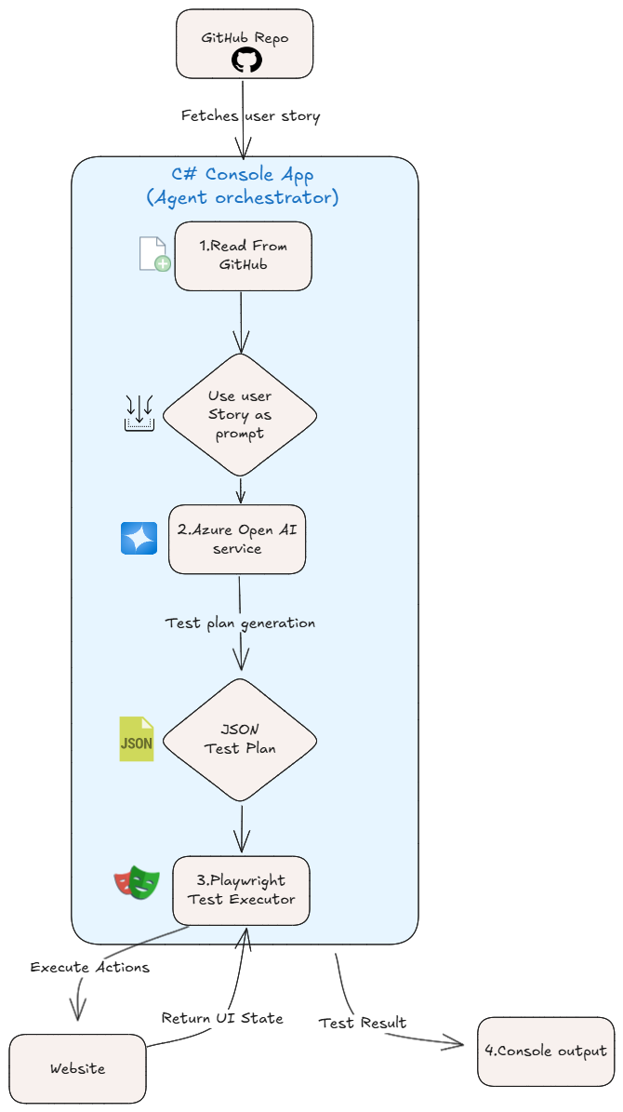
GitHub
Azure Open AI
Playwright
C#

Slide 10
03
Azure OpenAI

Slide 11
04
Live Demo!

Slide 12
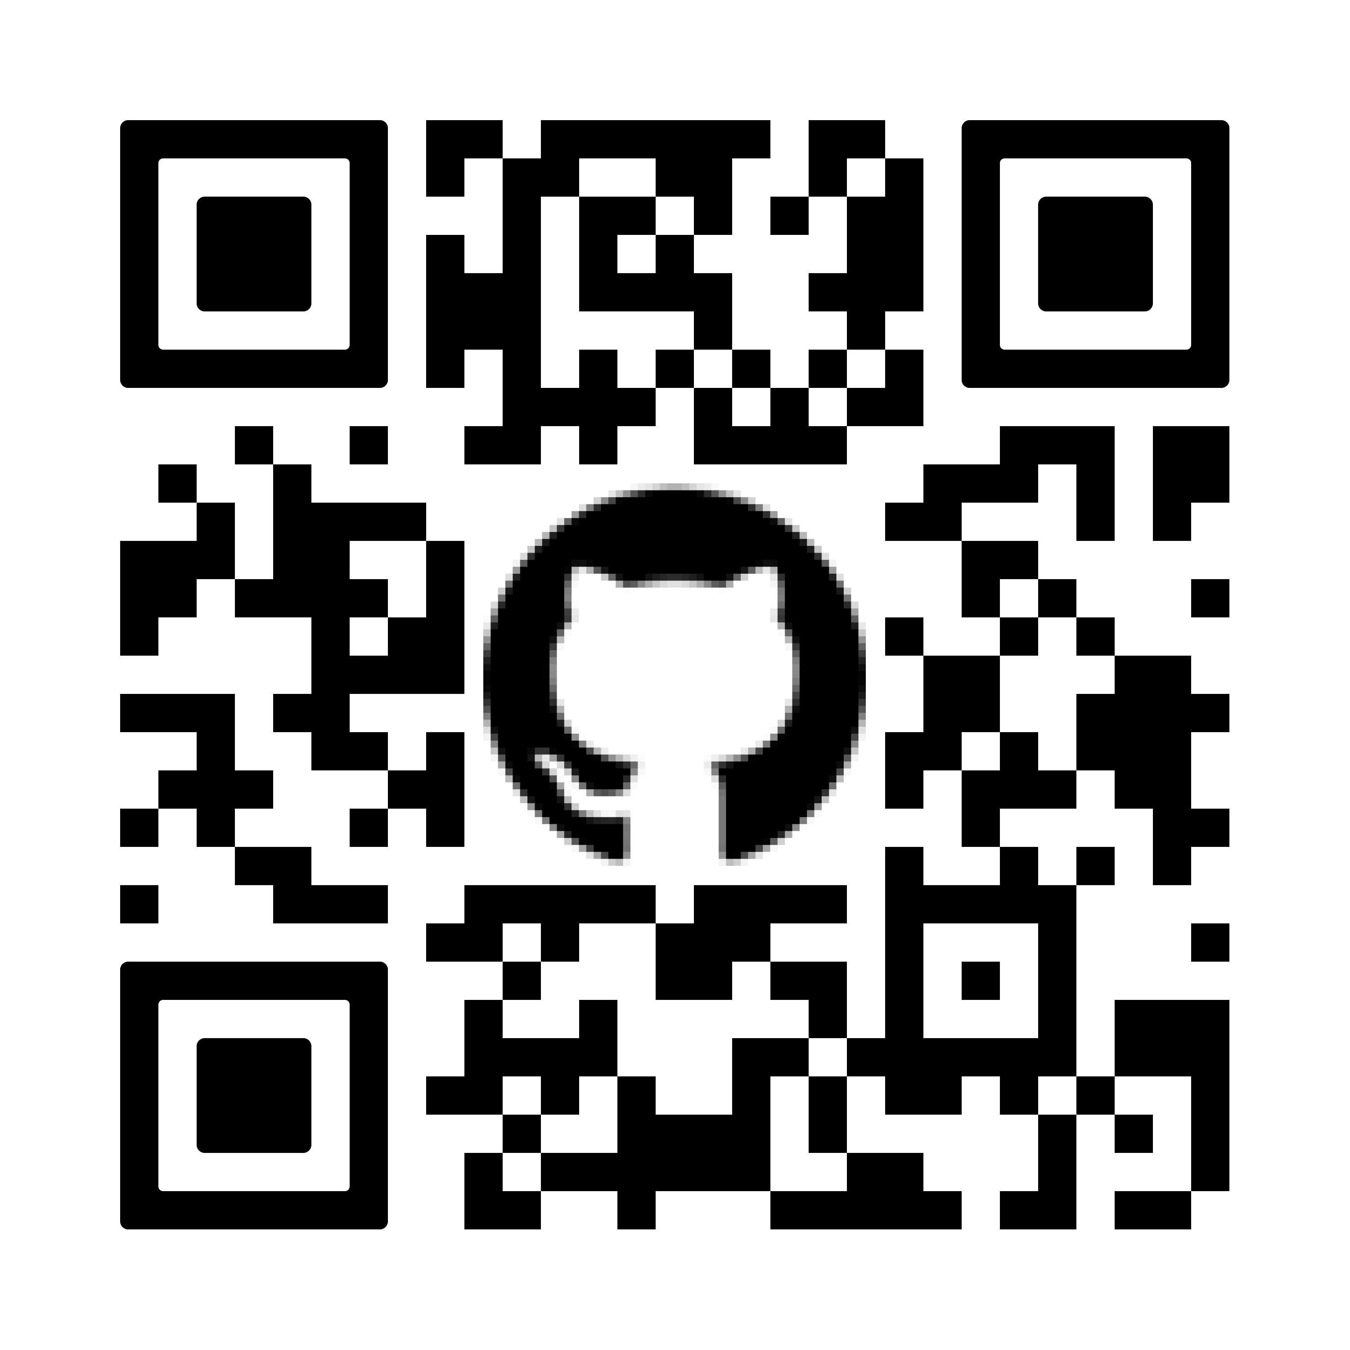
Questions ?​
Notes:
Useful resources https://www.saucedemo.com https://ai.azure.com

